Slide 1

workshop on modelling ... and regulation ...
our calculations …
Tony Warn MBE
December 2023

Slide 2
a legal objection to a permit calculation:
“I’ve proved your river flow was NOT log-normal !”

Slide 3
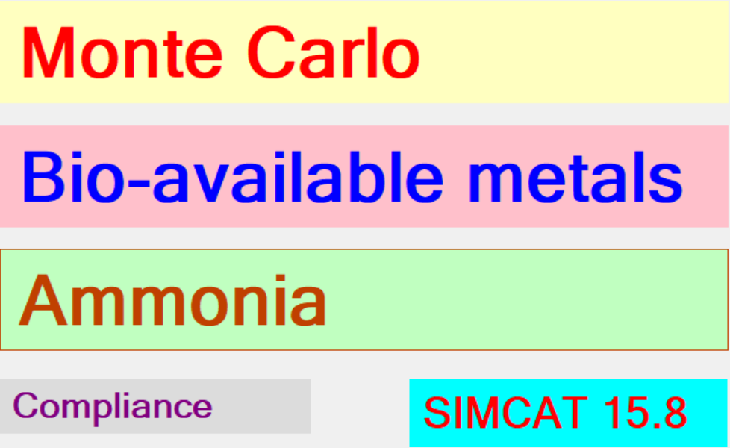
perform sensitivity tests ✓
replace lognormal with non-parametric ✓

Slide 4
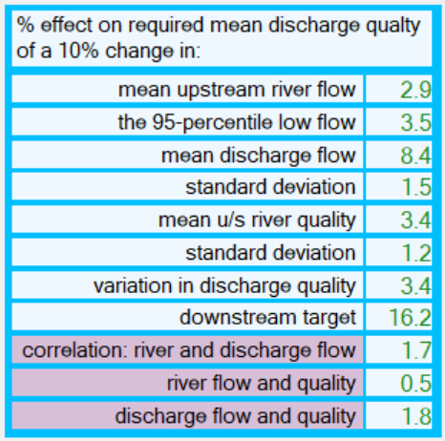

Slide 5
... we can then correctly
non-parametric flow gave:
50,000 values
a 2 % change in the permit
(the sampling errors total ± 14 %)

Slide 6
the “science” of taking decisions
and not just the science of rivers etc

Slide 7
this means we must:
know our errors
use a mathematically correct form of standard

Slide 8
know our errors ...
2.115
1.5 to 3.1

Slide 9
river FAILED ...
(with 93 % confidence)

Slide 10
a standard is not just
a level

Slide 11
a standard is...
a level
“a risk of it happening”

Slide 12
simplest option ...
annual mean
or percentile

Slide 13
... we can then correctly
work out controls
know our errors
assess confidence of failure
expose stupid national targets

Slide 14
why can we use the annual mean as a standard ?

Slide 15
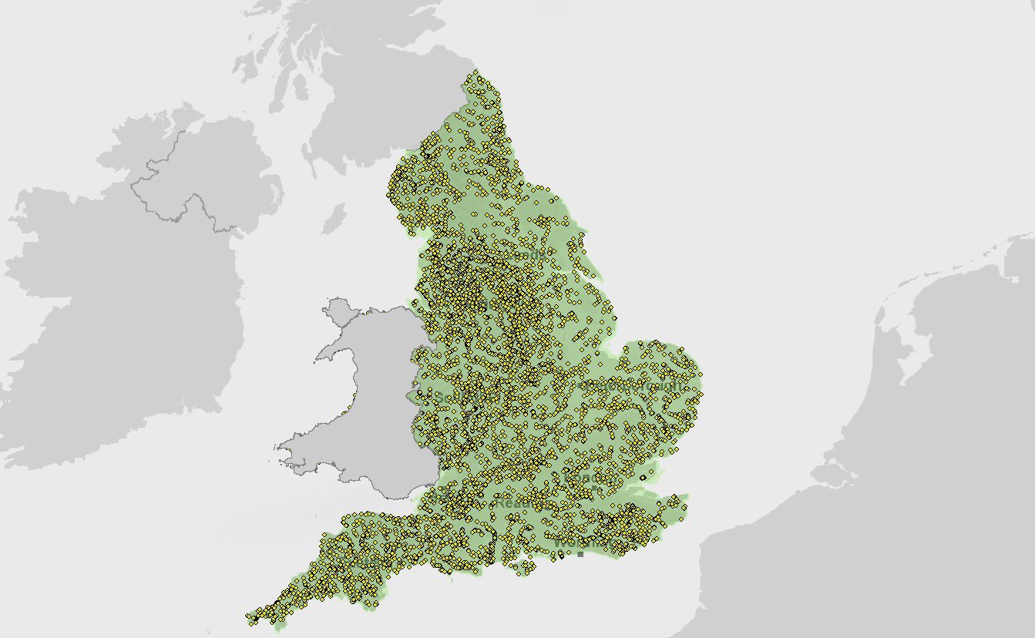
River Quality
6000 sites
(monthly samples)
for 60 years

Slide 16
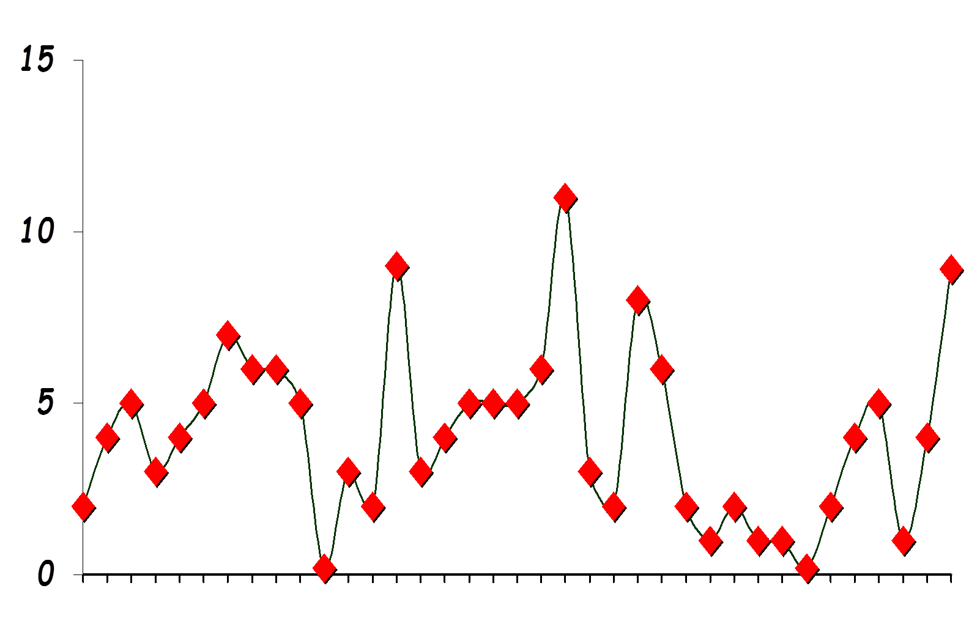
samples at one site
time

Slide 17
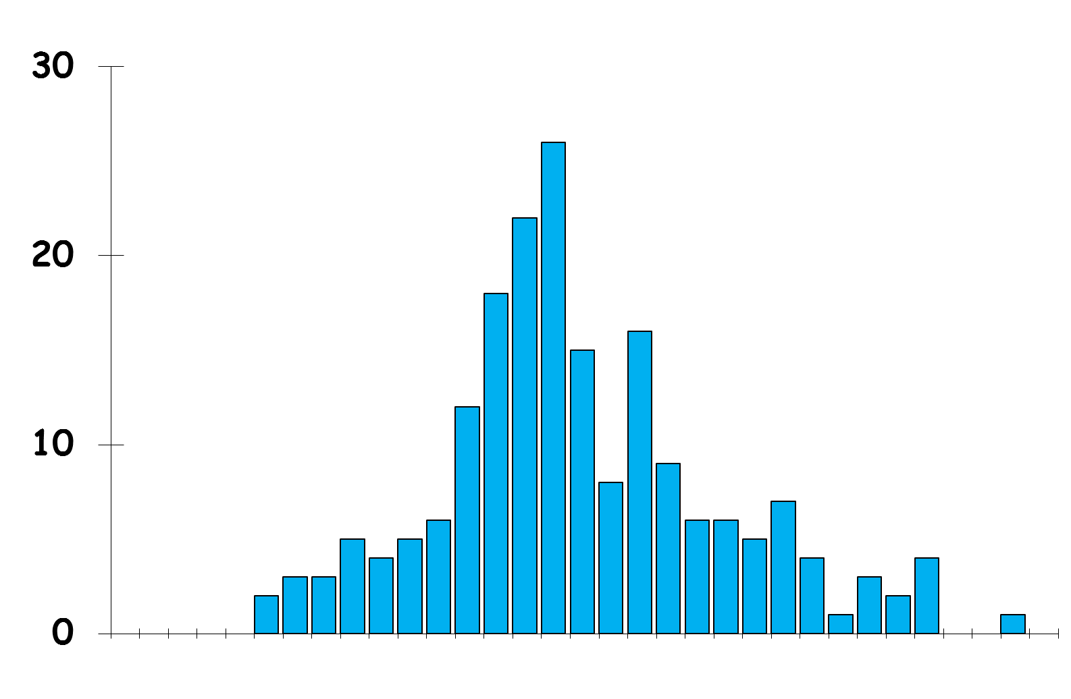
single site
concentration

Slide 19
persistent shape everywhere
fatness
varies
for a particular pollutant

Slide 20
... a mean can represent the shape
its sequences, variability,
randomness, correlations, and seasonality

Slide 21
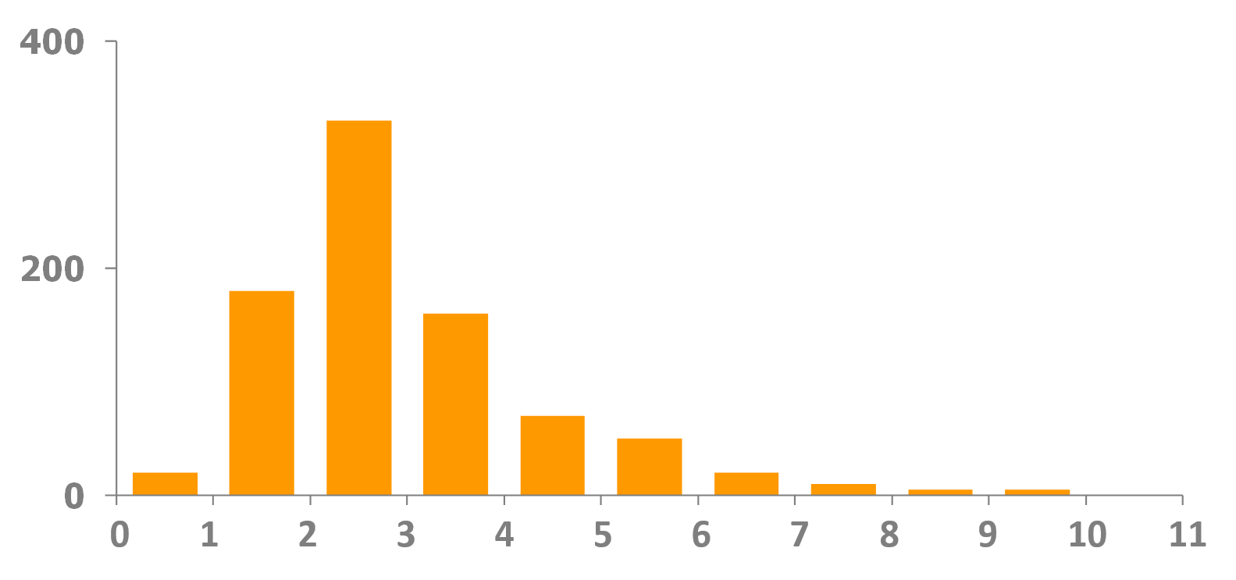
look at all sites of good biology
number of sites
annual mean of pollutant

Slide 22
90%
10%
number of sites
annual mean of pollutant

Slide 23
set a standard
number of sites
annual mean of pollutant

Slide 24
ammonia (90-percentiles)
high
good
upland
0.2
0.3
lowland
0.3
0.6

Slide 25
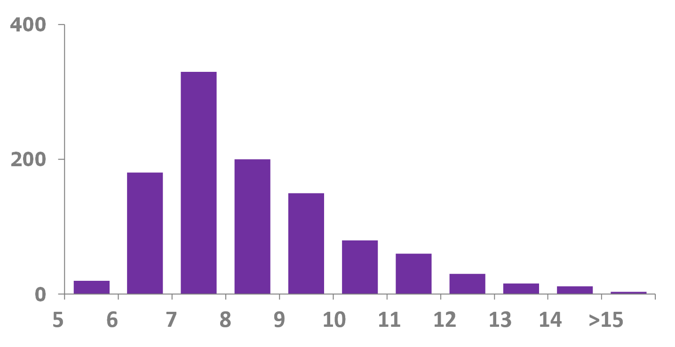
BAD sites
11%

Slide 26
use the standard over the years
confirm it works
update if necessary

Slide 27
90-percentile
if this standard is met …

Slide 28
90-percentile
it provides this shape

Slide 29
is it safe to change the shape?

Slide 30
look
at
discharge
quality

Slide 31
operator changes the shape
but still meets the permit

Slide 32
if you change the shape
you will need a new permit

Slide 33
the permit has all the benefits of the shape – built in

Slide 34
for your new shape we need, say
the shape
the mean
standard deviation
correlation coefficient for discharge flow river flow
and for discharge flow and quality

Slide 35
change the shape for river quality
..
90-percentile = 0.6
future
is this
safe?
now

Slide 36
we probably don’t know
we would need evidence

Slide 37
simplest option ...
annual mean
or percentile

Slide 38
“IDEAL” STANDARD …
what is the concentration ?
how often can it be exceeded ?
over what period of time ?
design risk (or return period) ?
(level of proof required for citing failure)

Slide 39
annual mean …
what is the concentration ?
how often can it be exceeded ?
over what period of time ?
design risk (or return period) ?
(level of proof required for citing failure)

Slide 40
more elaborate standards?
several concentrations
each with a duration
annual frequency
and return periods

Slide 41
more elaborate pollutants?
use DO rather than BOD
use “free” ammonia instead of total ammonia
bioavailable metals
different standards for every km

Slide 42
such elaborations are often unnecessary
especially with the errors from sampling that we are happy to live with

Slide 43
uncertainty because…
31 million seconds in a year
we take 12 samples

Slide 44
elaborations can be unnecessary
(and lead to bigger errors)

Slide 45
intermittent discharges

Slide 46
river concentration with
a 3 hour duration,
twice a year and a
12 month return period

Slide 47
set up
1000
scenarios
simulate 10 years
(minute-by-minute)

Slide 48
standards can be
replaced by
an annual
99-percentile

Slide 49
class limits ...
high
good
4
5
90-percentile
9
11
99-percentile

Slide 50
in decision-taking we must:
quantify our errors
use a correct form of standards

Slide 51
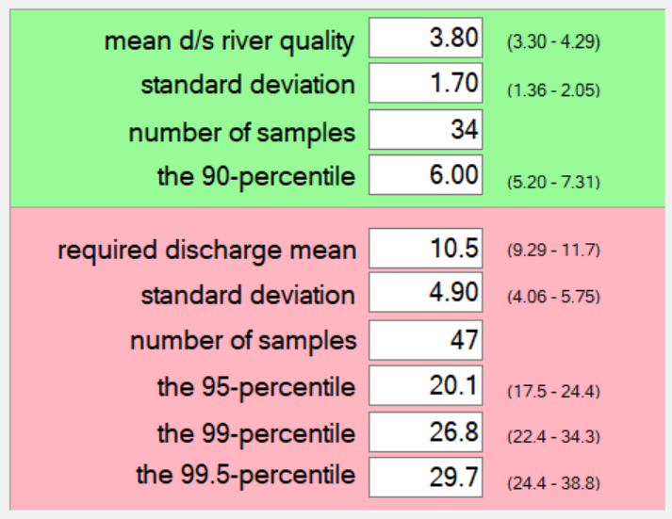

Slide 52
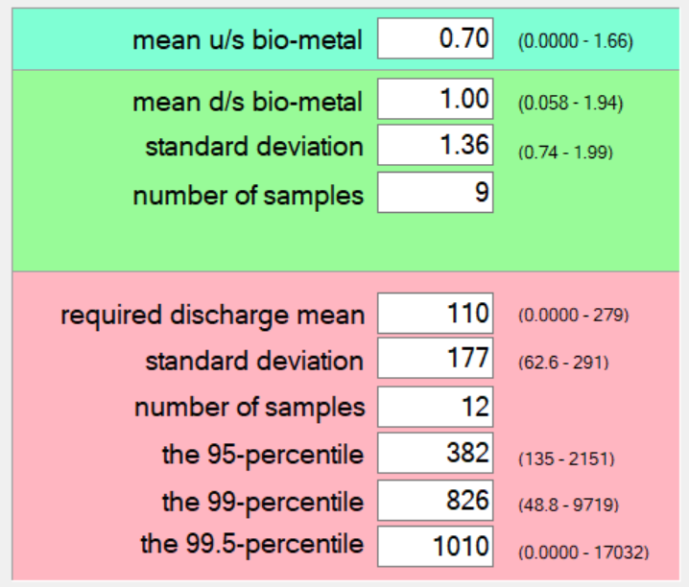


Slide 53
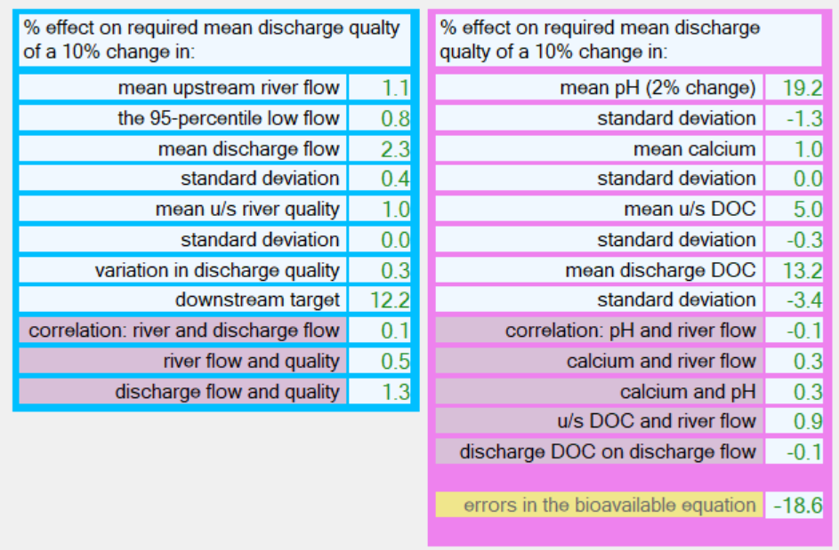

Slide 54
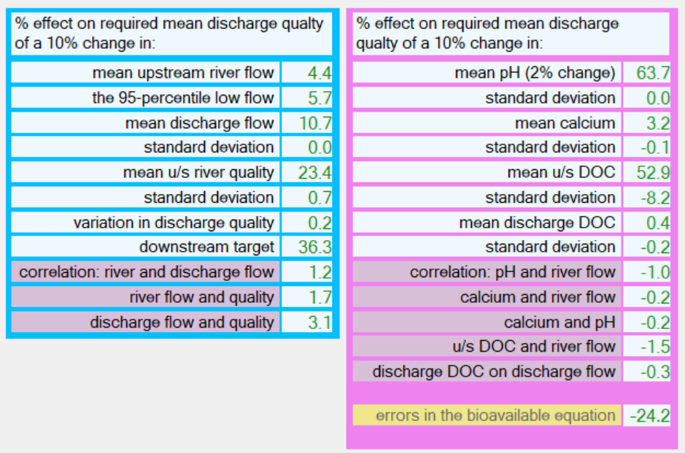

Slide 55

dissolved to bioavailable...
10 (± 23%)
10 (± 30%)

Slide 56
laws may cite a “weak” standard

Slide 57
a maximum of 50 ...
a specified sampling rate of 12 …
this is a 95-percentile with action at 54% confidence of failure …
with a sampling rate of 52: the standard is twice as strict

Slide 58
the estimate of the 95%-tile must meet the standard ...19 years in 20
this is a 98%-tile in the long run (twice as strict as the 95%-tile )

Slide 59
simplest option ...
annual mean
or percentile

Slide 60
... with such a standard, we can
assess compliance
detect deterioration

Slide 61
good
good
moderate
poor
bad
100%
error distribution
Notes:
61

Slide 62
good
good
moderate
poor
bad
30%
45%
20%
5%
Notes:
62

Slide 63
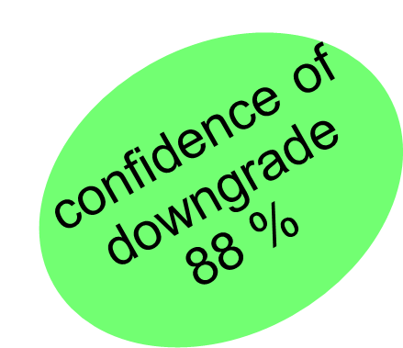
2012-15
-
40
60
-
-
2016-18
-
-
20
70
10

Slide 64
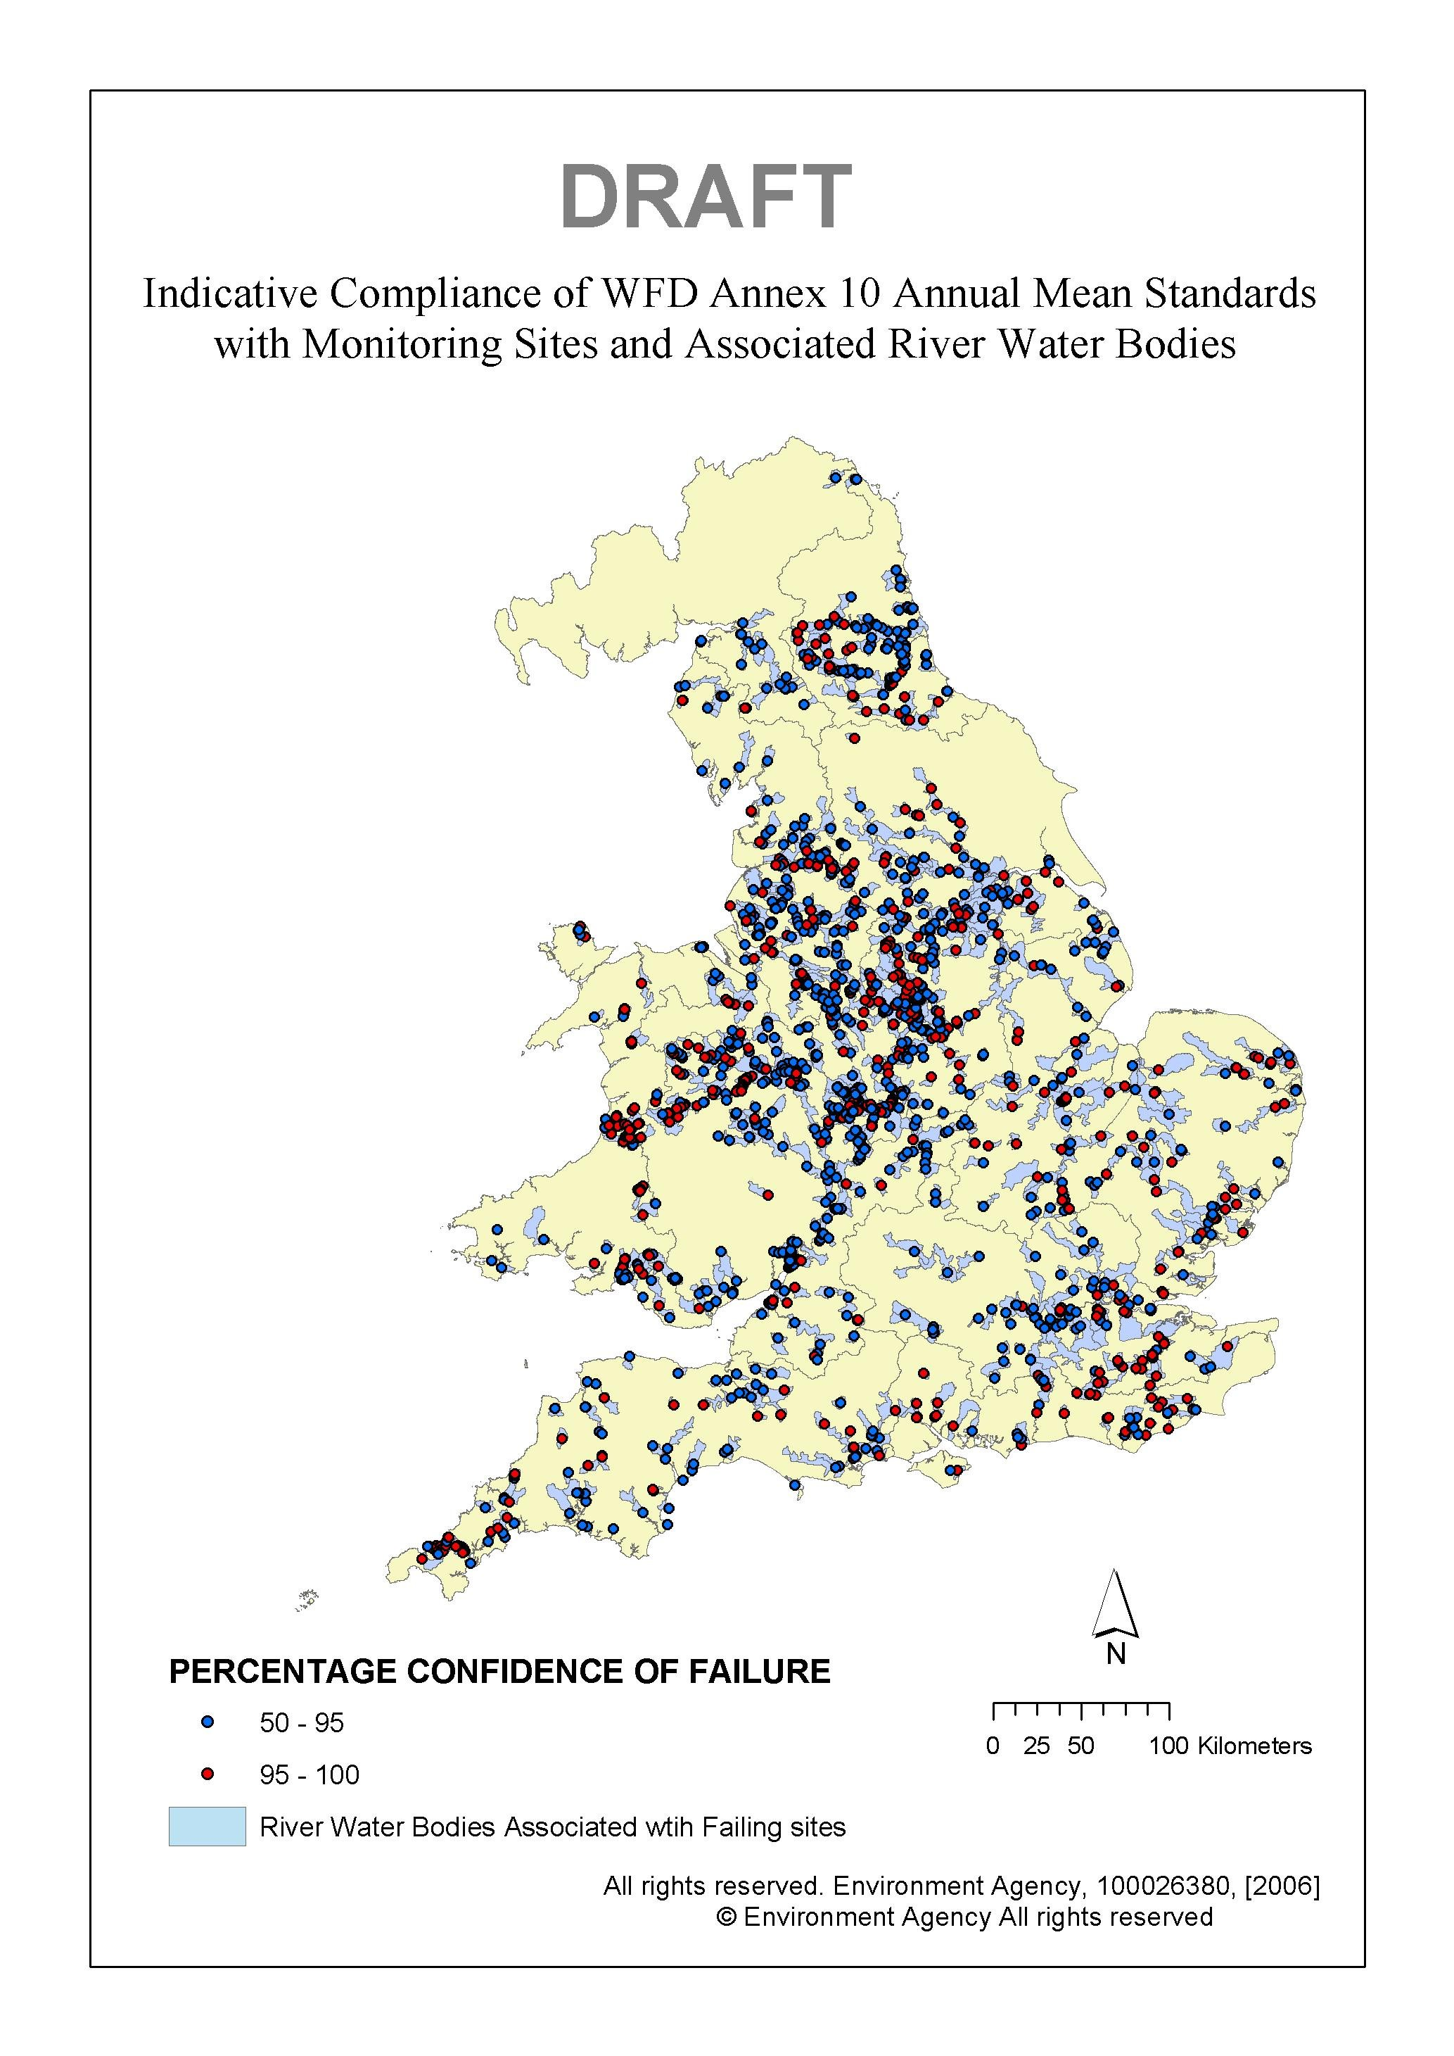
10%
sites
95% confidence
of failure
20%
sites
50% confidence
of failure

Slide 65
decision making ...
where is the red on the map ? ?
what caused it ?
how confident are we ?
what can we do ?
is it worth doing ?
help from models

Slide 66
investigate actions needed to meet targets

Slide 67
... for example
national controls
site-specific controls
a mix of these

Slide 68
... use RQP/SIMCAT to look at
for each
red point
on the map
site-specific controls at locations

Slide 69
single discharge
flow and
concentration
flow and
concentration
flow and
concentration
Notes:
The biological condition of waters is determined by water quality, hydrology and morphology.
If these are in a good condition then biology will be good
Therefore we must manage the w

Slide 70
how do we do the mixing calculations?

Slide 71
mix the annual means ?
M
M
+
m
m
=
M
M
+
m

Slide 72
model several years of daily data?
... to nail down concentrations and frequency of occurrence

Slide 73
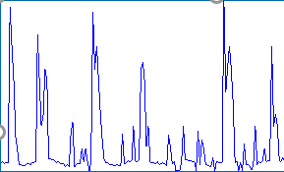
Notes:
The biological condition of waters is determined by water quality, hydrology and morphology.
If these are in a good condition then biology will be good
Therefore we must manage the w

Slide 74
but nearly always it is better and easier to use Monte Carlo
and we have limited data …
… and its associated errors

Slide 75
mix the distributions
C
f
Monte Carlo simulation
F
T
C
Notes:
The biological condition of waters is determined by water quality, hydrology and morphology.
If these are in a good condition then biology will be good
Therefore we must manage the w

Slide 76
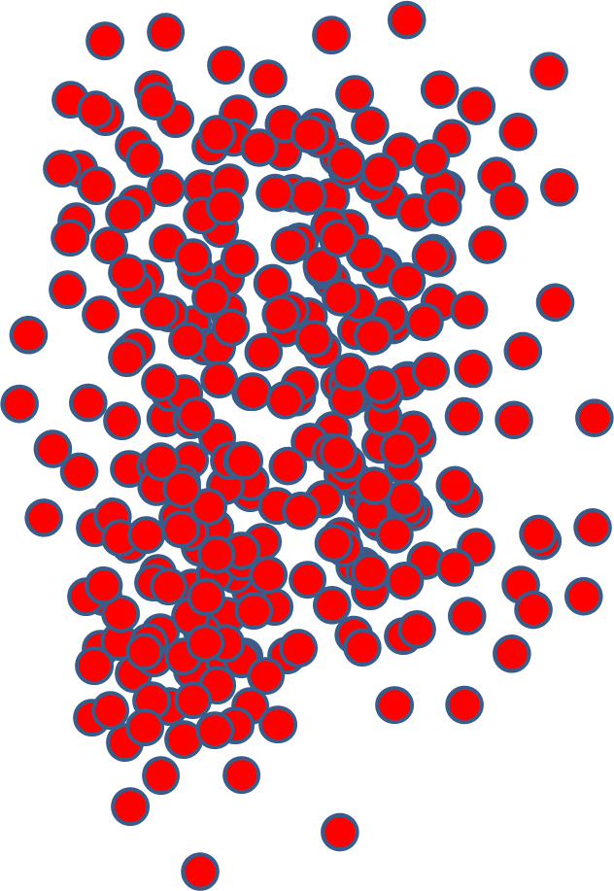
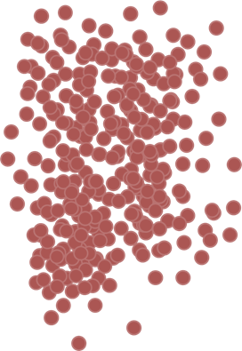
mix the correlated shots
Notes:
The biological condition of waters is determined by water quality, hydrology and morphology.
If these are in a good condition then biology will be good
Therefore we must manage the w

Slide 77
whole catchment
whole country

Slide 78
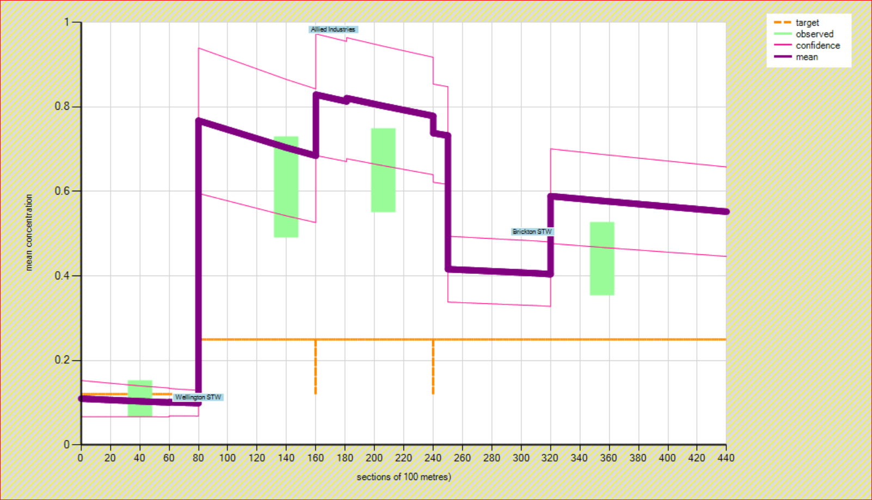

Slide 79
work out controls ✓
quantify the errors ✓
relate to national targets ✓

Slide 80
national controls?
uniform standards on all discharges?
a ban on chemicals?
limits on land-use?

Slide 81
reduced sampling big errors
weakens the case for site-by-site controls
(sometimes ignored bad decisions)
we default to regional or national controls (uniform permit limits everywhere, a ban on chemicals ?)

Slide 82
national target
reduce national % of failed sites ... (not named failed sites)

Slide 83
national target ?
76% of rivers GOOD by 2027 ?

Slide 84
complications ?
more than one pollutant ?
does One out – All out apply ?

Slide 85
Bon Ferroni
a site must meet standards for 6 pollutants
if each risks a wrong report of failure in 1 year in 10
the site will “fail” 5 years in 10
with 20 standards this rises to 9 in 10

Slide 86
consequences of One-out – All-out ...
10 determinands in 2017
25 determinands in 2027
more reported failed rivers ... even when there are actually less!
●
●

Slide 87
we must have sensible national targets !!
or deterioration will be reported whilst rivers are actually improving

Slide 88
new standard for a pollutant ?

Slide 89
new standard for phosphorus
cost = £6 billion
unaffordable?

Slide 90
do these sums on day one of your project …

Slide 91
new standard for nitrate
cost = £14 billion
unaffordable?

Slide 92
apportionment …
load from discharges
loads from diffuse
SAGIS

Slide 93
for each shot SIMCAT knows the load and concentration provided from each of:
20 types of diffuse pollution, and
1000s of upstream discharges

Slide 94
and SIMCAT knows the contributions to the annual mean concentration
not the same as the contribution to annual mean load

Slide 95
do we need to elaborate on the details ?

Slide 96
depth, width …
time of travel …
complex natural purification ...
diurnal variations …
chemical speciation …
settlement, re-suspension ...
rainfall – run off …
sewers ...
groundwater contributions ...
monthly breakdowns and results ...
unionised
ammonia?
standards that
differ for
every km?

Slide 97
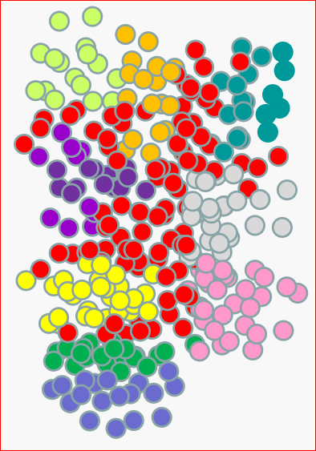
use of monthly data in SIMCAT is pointless:
(except perhaps where a river interacts with a lake)
any month-by-month output results have big errors
the use corrupts the Monte Carlo correlation

Slide 98
we know our errors ...
20 ( 16 - 24 )
is the change worth doing ?

Slide 99
use SAGIS to augment knowledge provided by sampling ?

Slide 100
the END ...
we have looked at the importance of the science of taking decisions

Slide 101
we have looked at ...
our form of standards – their help and limitations
always expressing our errors
calculating confidence in success or failure
Monte Carlo – calculating site specific and national actions
apportionment between sources of pollution
the introduction of new standards for rivers
ensuring sensible national targets
and sensible legal standards
standards that
differ for
every km?

Slide 102
feedback welcome!
copy of slides
a summary report

Slide 103
workshop on modelling ... and regulation ...
our calculations …
Tony Warn MBE
December 2023

